Slide 1
Tutorial 4 Graphic Design with CSS

Slide 2
Objectives
Create a figure box
Add a background image
Add a border to an element
Create rounded borders
Create a graphic border
Create a text shadow

Slide 3
Objectives (continued)
Create a box shadow
Create linear and radial gradients
Set the opacity of an element
Apply a 2D and 3D transformation
Apply a CSS filter
Create an image map

Slide 4
Creating Figure Boxes
Figure and figcaption are often placed within a separate box that stands apart from the main content of the article
figure and figcaption elements:
They are used by HTML5 to introduce structural elements
The figcaption element is optional
The figcaption element can be placed directly before or after a figure box content

Slide 5
Creating Figure Boxes
The general syntax to create a figure box is as follows:
<figure>
content
<figcaption>caption text</figcaption>
</figure>
content is the content appearing in a figure box
caption text is the description text that accompanies the figure

Slide 6
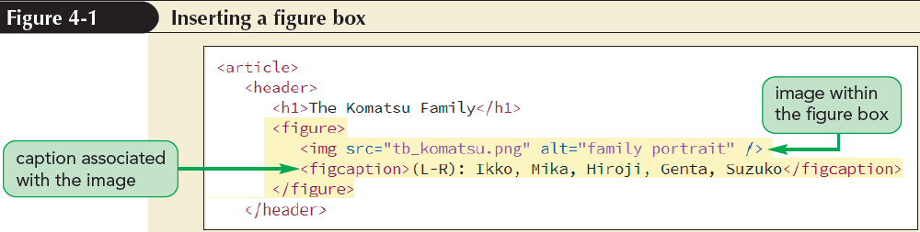
Creating Figure Boxes
The figure element – Used to mark a page content that should stand apart from the main content

Slide 7
Working with Image Maps
When an inline image is marked as a hyperlink, the entire image is linked to the same file
HTML allows an image to be divided into different zones, or hotspots
Hotspots can be linked to different URLs through information given in an image map

Slide 8
Working with Image Maps
Image maps supported by HTML:
Client-side image map – Image map defined within a web page and handled entirely by the web browser
Server-side image map – Image map that relies on a program running on the web server to create and administer the map

Slide 9
Defining a Client-Side Image Map
Client-side image maps are defined with the following map element:
<map name=“text”>
hotspots
</map>
text is the name of the image map
hotspots are the defined regions within an image that are linked to different URLs

Slide 10
Defining a Client-Side Image Map
They can be placed anywhere within the body of a web page
They are not actually displayed by browsers
They are simply used as references for mapping the locations of the hotspots within the image
The most common practice is to place a map element below the corresponding image

Slide 11
Defining a Client-Side Image Map
Hotspot within the map element can be defined using the following element:
<area shape=“shape” coords=“coordinates”
href=“url” alt=“text” />
shape is the shape of the hotspot region using rect, circle and poly
coordinates are the list of points that define the boundaries of that region
url is the URL of the hypertext link
text is alternate text displayed for non-graphical browsers

Slide 12
Defining a Client-Side Image Map
shape=“rect” coords=“left, top, right, bottom”
Circular hotspots are defined using the attributes
shape=“circle” coords=“x, y, radius”
where x and y are the coordinates of the center of the circle and radius is the circle’s radius
shape=“poly” coords=“x1,y1,x2,y2,……”

Slide 13
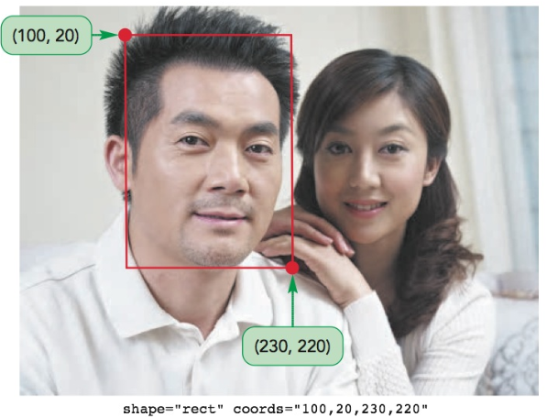
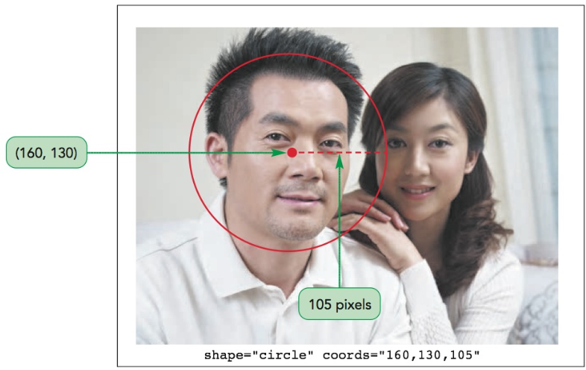
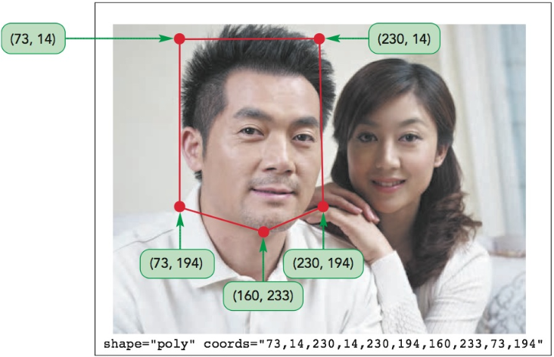
Client-Side Image Map

Slide 14
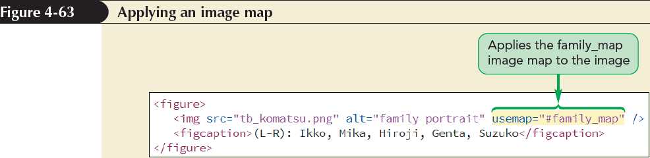
Applying an Image Map
An image map can be applied to an image using the following usemap attribute to the img element:
<img src=“url” alt=“text” usemap=“#map” />
where map is the name assigned to the image map within the current HTML file

Slide 15
Exploring Background Styles
The use of images for backgrounds is supported by CSS using the following background-image style:
background-image: url(url);
url specifies the name and location of the background image

Slide 16
Tiling a Background Image
Tiling – The process of repeating an image both vertically and horizontally until the background is filled
The type of tiling can be specified by applying the following background-repeat style:
background-repeat: type;
where type can be repeat (the default), repeat-x, repeat-y, round, or space

Slide 17
Attaching the Background Image
A background image is attached to its element so that it scrolls when the element content is scrolled
The attachment can be changed using the following property:
background-attachment: type;
where type is scroll (the default), fixed, or local

Slide 18
Attaching the Background Image
type in the background-attachment property:
scroll sets the background to scroll with the element content
fixed creates a background that stays in place even as the element content is scrolled. It is sometimes used to create watermarks
local allows the element background to scroll along with the content within the box. It is used for elements, such as scroll boxes

Slide 19
Attaching the Background Image
Watermarks:
Translucent graphics displayed behind a content
They can be created using fixed backgrounds
Often used to indicate that a content material is copyrighted

Slide 20
Setting the Background Image Position
By default, background images are placed in an element’s top-left corner
The following property can be used to set the position of a background image:
background-position: horizontal vertical;
where horizontal and vertical provide the coordinates of an image within the element background expressed using one of the CSS units of measure or as a percentages
background-position: 10% 20%;

Slide 21
Setting the Background Image Position
Keywords to position a background image are as follows:
left, center, and right are used to position the background horizontally
top, center, and bottom are used to position the background vertically
background-position: right bottom
The background-position property is only useful for non-tiled images

Slide 22
Defining the Extent of the Background
An element’s background extends only through the padding space excluding the border space
This can be changed using the following property:
background-clip: type;

Slide 23
Defining the Extent of the Background
type in the background-clip property:
content-box extends the background only through the element content
padding-box extends the background through the padding space
border-box extends the background through the border space

Slide 24
Sizing and Clipping an Image
By default, the size of a background image equals the size stored in its image file
This size can be changed by using the following property:
background-size: width height;
where width and height can be specified in one of the CSS units of length or as a percentage or by using the keywords auto, cover, and contain
e.g. background-size: 300px 200px;
background-size: auto 200px;

Slide 25
Sizing and Clipping an Image
Auto: tells the browser to automatically set the width or height value based on the dimensions of the original image
Cover: tells the browser to resize the image to cover all the element background while still retaining the image proportions
Contain: scales the image so that it’s completely contained within the element

Slide 26
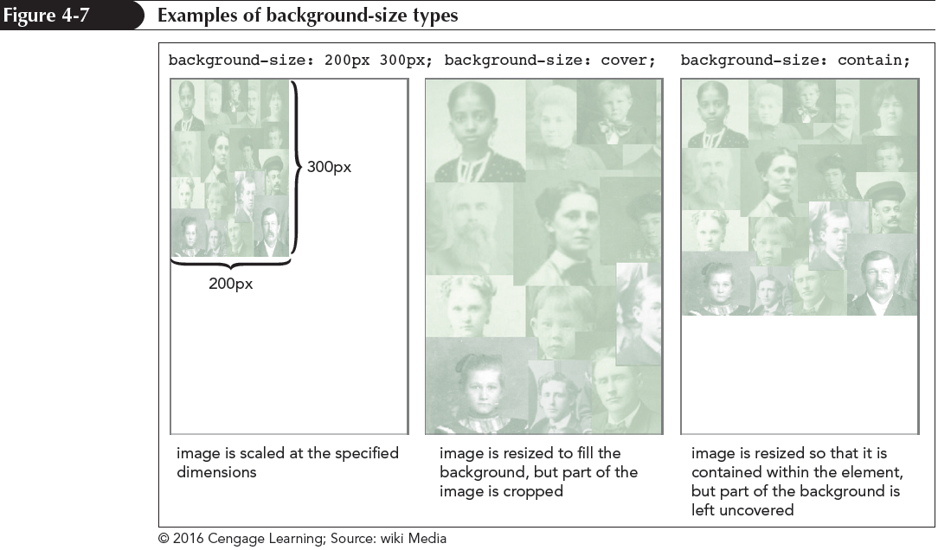
Sizing and Clipping an Image

Slide 27
The background Property
Different background options can be organized using the following property:
background: color url(url) position/size repeat attachment origin clip;
color is the background color
url is the source of the background image
position is the image’s position
size sets the image size
repeat sets the tiling of the image

Slide 28
The background Property
attachment specifies whether the image scrolls with the content or is fixed
origin defines how positions are measured on the background
clip specifies the extent over which the background is spread
div{
background:url(background.jfif) bottom / auto 300px no-repeat content-box;
}

Slide 29
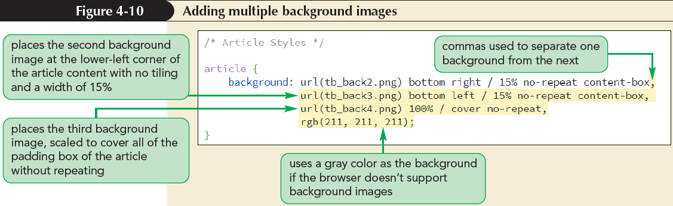
Adding Multiple Backgrounds
Multiple backgrounds can be added to a single element by listing the backgrounds in the following comma-separated list:
background: background1, background2, …;

Slide 30
Working with Borders Setting Border Width and Color
There are several style properties that can be used to format the border around each element using CSS
To define the thickness of a specific border, the following property can be used:
border-side-width: width;
side is either top, right, bottom, or left
width is the width of the border (thin, medium, thick)
border-width: top right bottom left;
border-width: 10px 20px;

Slide 31
Setting the Border Design
The appearance of borders can be further defined by using the following style:
border-side-style: style;
The color or each individual border is set using the property
border-side-color: color;
border-color: color;

Slide 32
Creating Rounded Corners
Any of the four corners of a border can be rounded off by applying the following property:
border-radius: top-left top-right bottom-right bottom-left;
where top-left, top-right, bottom-right, and bottom-left are the radii of the individual corners
border-radius: horizontal/vertical

Slide 33
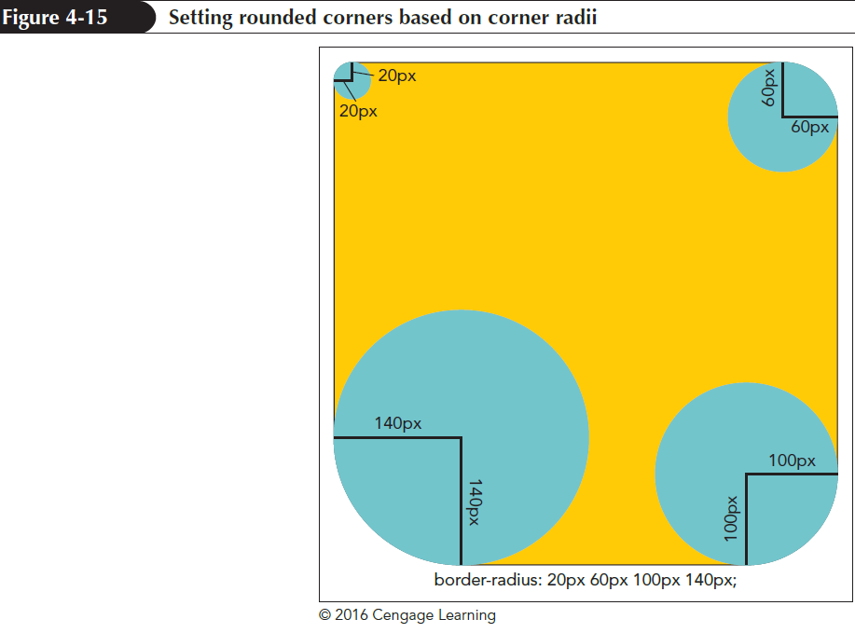
Creating Rounded Corners

Slide 34
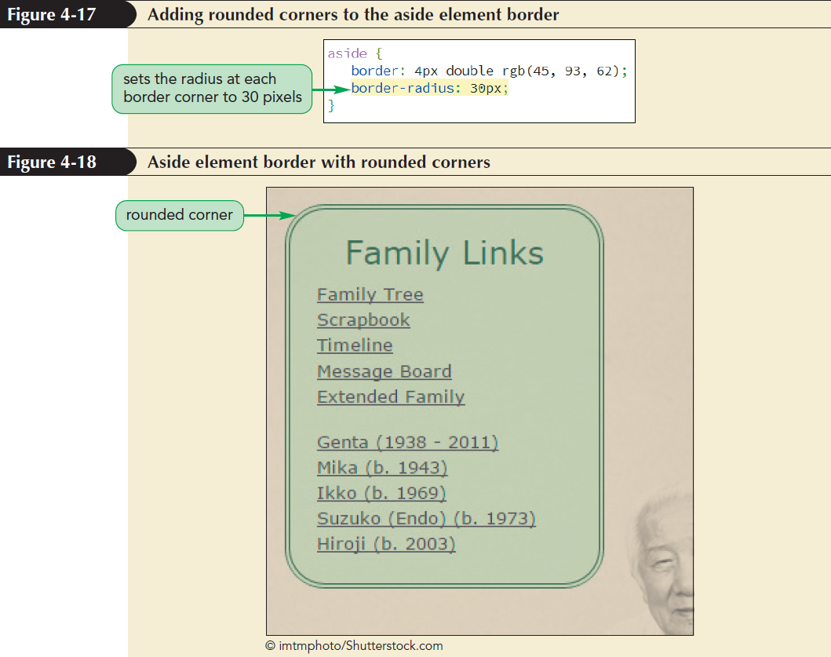
Creating Rounded Corners

Slide 35
Applying a Border Image
A border image is a border based on a graphic image
The graphic image is sliced into nine sections representing the four corners, the four sides, and the interior piece
The content of the object appears in the interior piece and this piece is discarded

Slide 36
Applying a Border Image
The four corners become the corners of the border
The four sides are either stretched or tiled to fill in the border’s top, right, bottom, and left sides

Slide 37
Applying a Border Image
A border image is applied using the following property:
border-image: url(url) slice repeat;
url indicates the source of the graphic image
slice indicates the width or height of the slice used to create the sides and corners
repeat indicates whether the side slices should be stretched or tiled to cover the four sides of the border

Slide 38
Applying a Border Image
The repeat option supports the following values:
stretch: The slices are stretched to fill each side
repeat: The slices are tiled to fill each side
round: When the slices are tiled to fill each side, if they do not fill the sides with an integer number of tiles, the slices are rescaled until they do
space: When the slices are tiled to fill each side, if they do not fill the sides with an integer number of tiles, extra space is distributed around the tiles

Slide 39
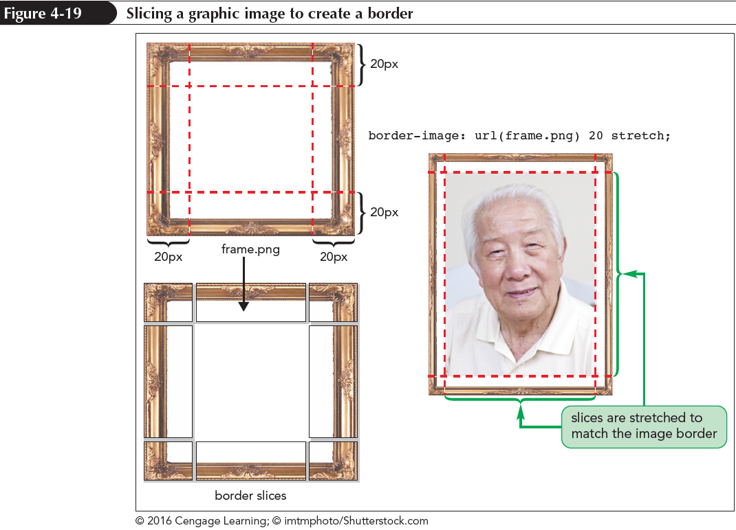
Applying a Border Image

Slide 40
Creating a Text Shadow
A shadow can be added to a text on a page, to give the text a visual impact, by using the following property:
text-shadow: color offsetX offsetY blur;
color is the shadow color
offsetX and offsetY are the distances of the shadow from the text in the horizontal and vertical directions
blur creates a blurred effect by spreading out a shadow

Slide 41
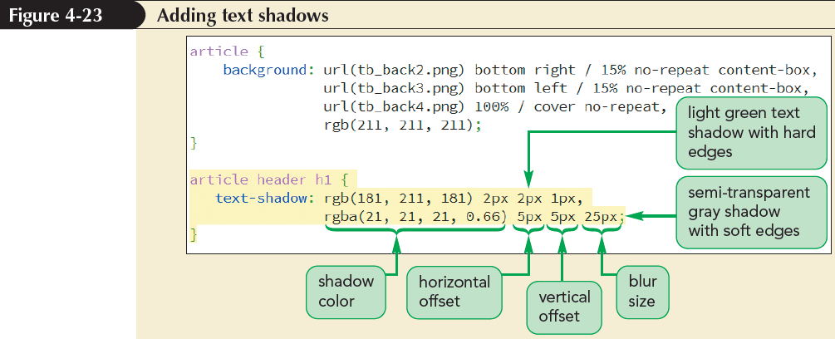
Creating a Text Shadow

Slide 42
Creating a Box Shadow
Any block element can be shadowed by using the box-shadow property
box-shadow: color offsetX offsetY blur;
where color, offsetX, offsetY, and blur have the same meanings for box shadows as they do for text shadows
Multiple shadows can be added by including them in a comma-separated list

Slide 43
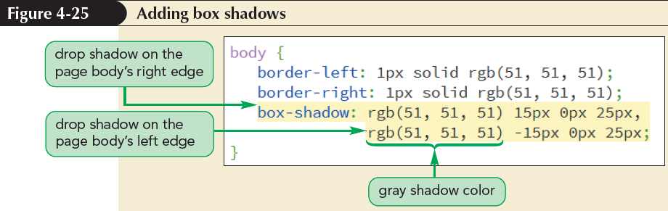
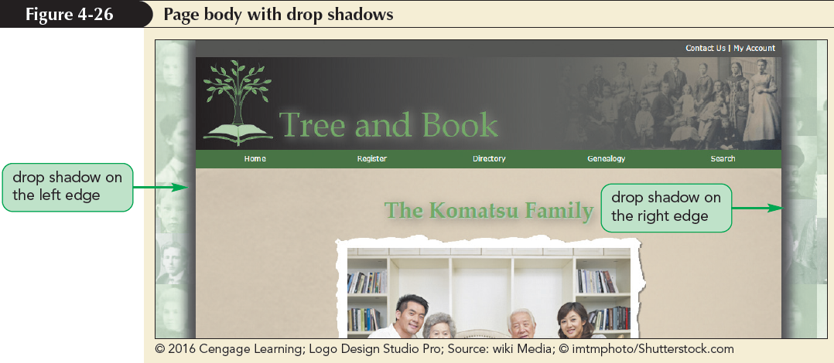
Creating a Box Shadow

Slide 44
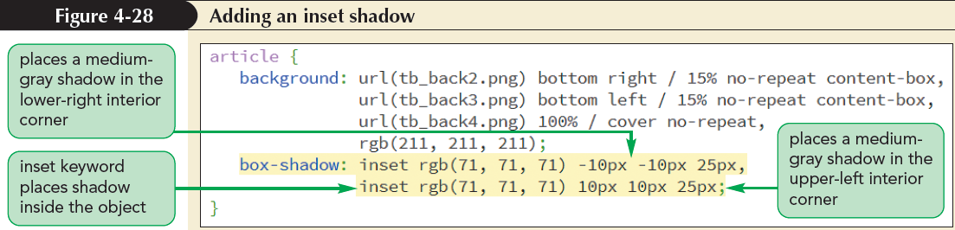
Creating a Box Shadow
Box shadows can be placed inside the element using inset keyword to the box-shadow property

Slide 45
Applying a Color Gradient
Color gradient:
One color gradually blends into another color or fades away if transparent colors are used
It can be used to modify a background color
Linear gradient:
Background colors transition from a starting color to an ending color along a straight line
The default direction is vertical, starting from top and moving to bottom

Slide 46
Gradients and Color Stops
linear-gradient(color1, color2,…)
The colors specified in a gradient are evenly distributed
The following gradient starts with a solid red, solid green appears halfway through the gradient, and finishes with solid blue:
background: linear-gradient(red, green, blue)

Slide 47
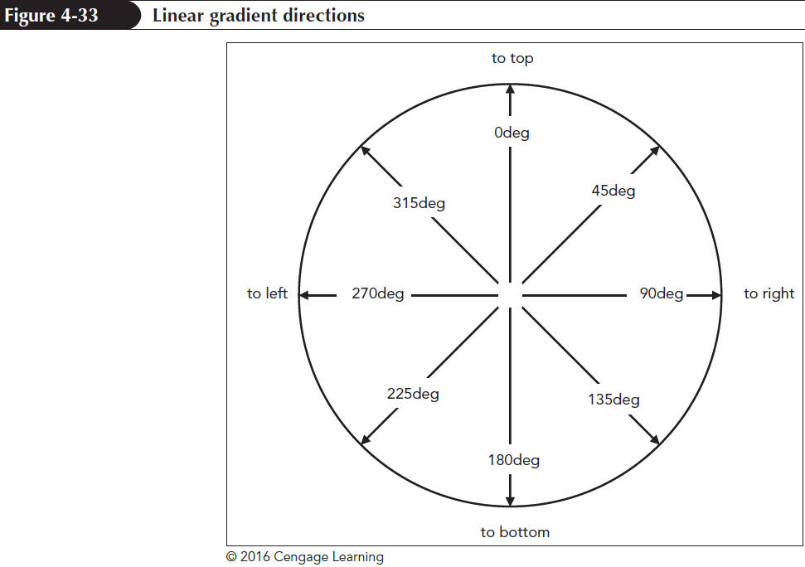
Applying a Color Gradient

Slide 48
Gradients and Color Stops
linear-gradient(direction, color1, color2,…)
linear-gradient(to left, red, yellow, blue)
linear-gradient(to bottom right, red, yellow, blue)
linear-gradient(60deg, red, yellow, blue)
linear-gradient(direction, color-stop1, color-stop2,…)
linear-gradient(red 25%, green 75%, blue 95%)

Slide 49
Creating a Radial Gradient
Radial gradient:
It is a color gradient that starts from a central point
It proceeds outward in a series of concentric circles or ellipses

Slide 50
Creating a Radial Gradient
Radial gradients are created using the following radial-gradient function:
radial-gradient(shape size at position, color-stop1, color-stop2, …)
shape defines the shape of the gradient either ellipse (the default) or circle
position defines where the gradients radiate from using pixels, percentage or keywords: left, center, right, top and bottom
color-stop1, color-stop2, … specify the colors and their stopping positions

Slide 51
Creating a Radial Gradient
The size value in the radial-gradient function:
defines the extent of the gradient as it radiates outward
can be expressed with a CSS unit of measure
can be expressed as a percentage of the background’s width and height
can also be expressed with one of the following keywords: farthest-corner (the default), farthest-side, closest-corner, and closest-side

Slide 52
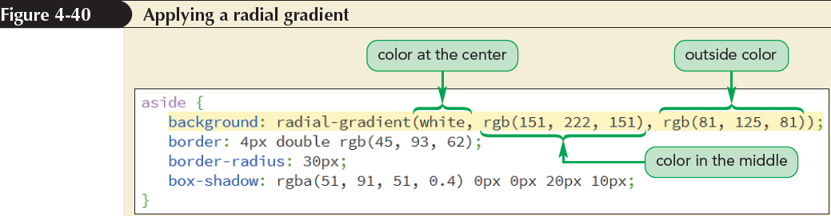
Creating a Radial Gradient

Slide 53
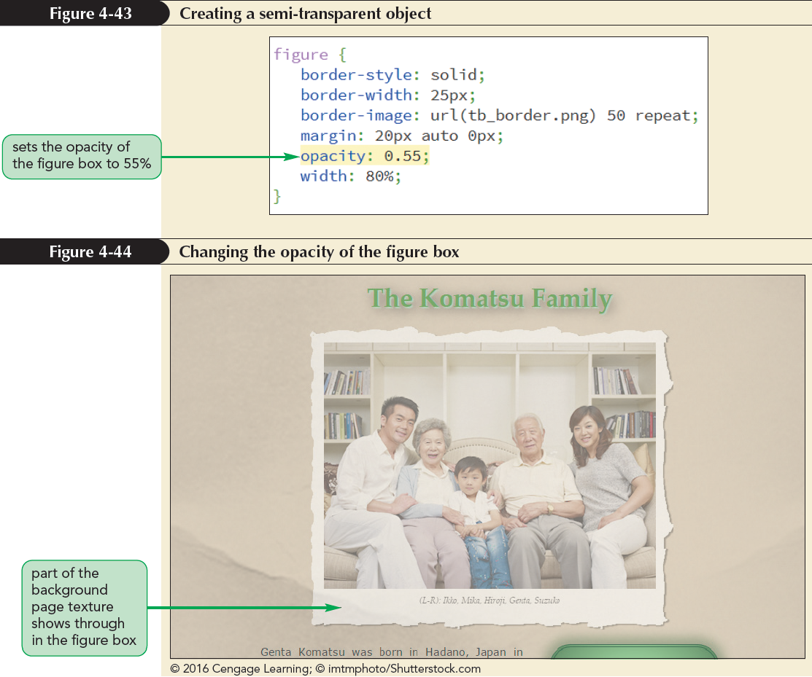
Creating Semi-Transparent Objects
Semi-Transparent colors can be created using the opacity property

Slide 54
Exploring CSS filters
Filters adjust how a browser renders an image, a background, or a border
Filters modify an object’s color, brightness, contrast, or general appearance
Filters can be applied using the following property:
filter: effect(params);
effect is a filter function
params specify the parameters of filter function

Slide 55
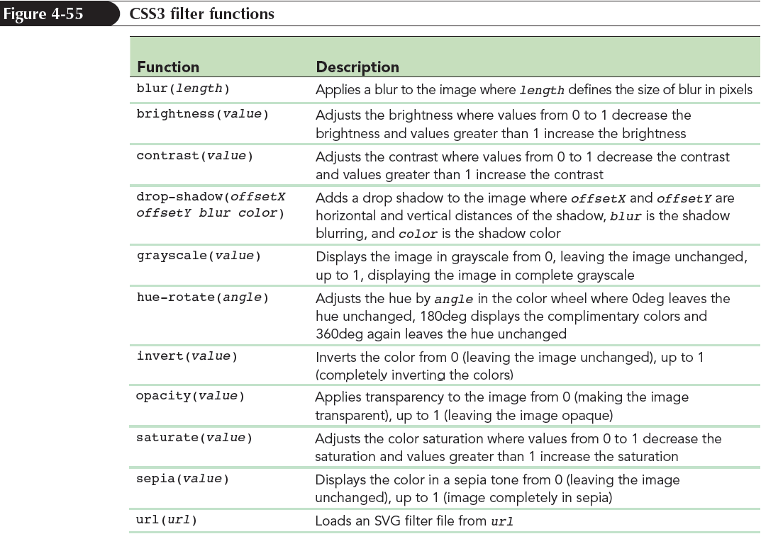
Exploring CSS filters

Slide 56
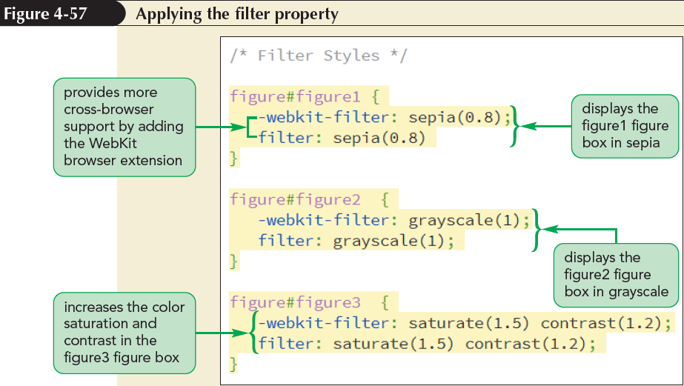
Exploring CSS filters

